Slide 1
Lights On Afterschool 101
October 26, 2023
Notes:
Hello everyone, and thank you for joining us for today’s webinar! My name is [NAME] and I will be one of your presenters today.
In today’s webinar our goal is two-fold: first, we will give a broad overview of why advocating for afterschool is so crucial in the current policy environment, and second, we will be going into the basics of planning a successful Lights On Afterschool event and discuss some strategies to engage policy makers and maximize the impact of your celebration.

Slide 2
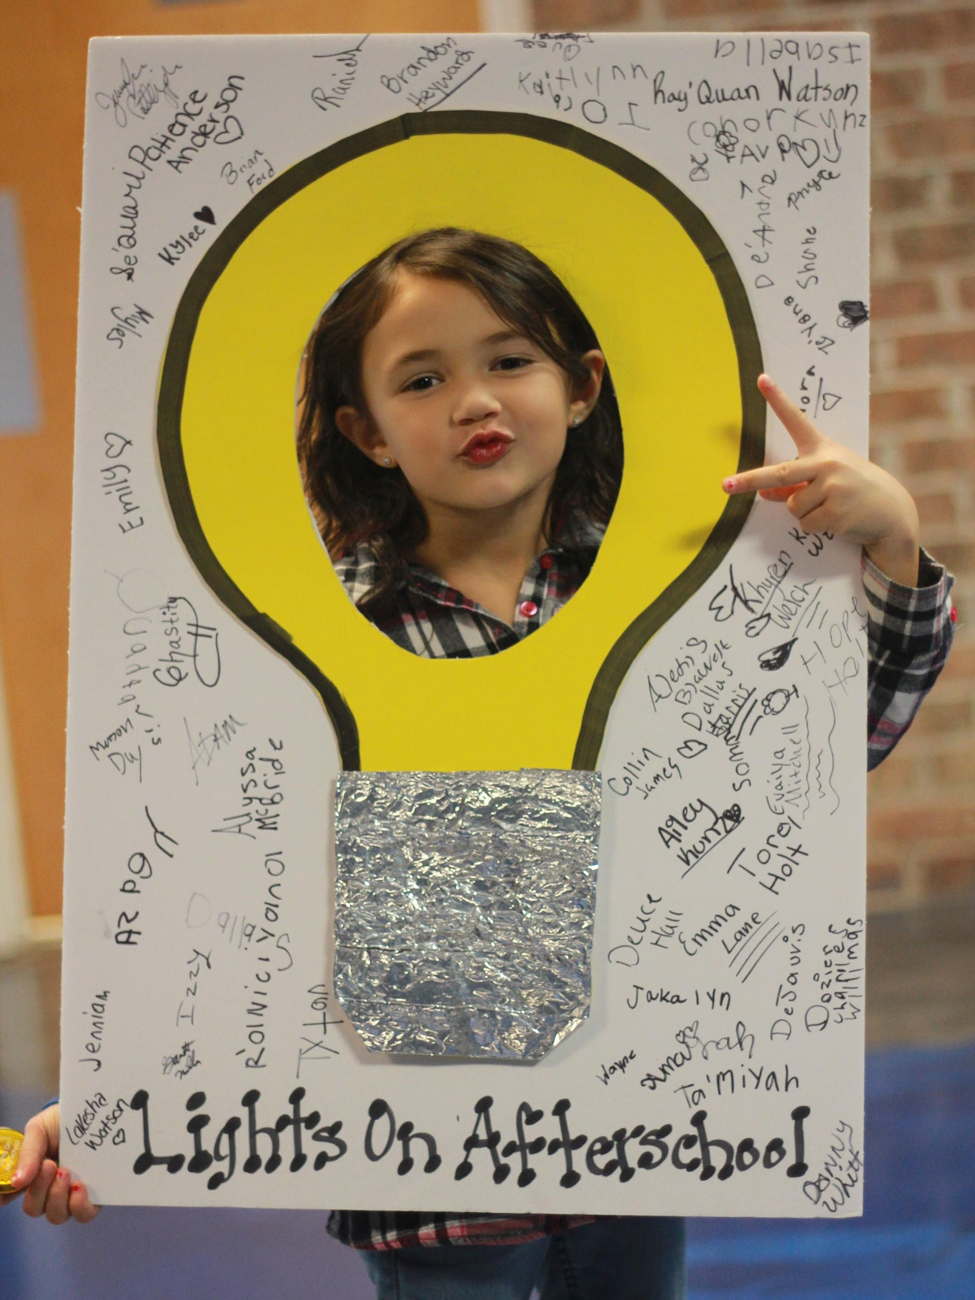
Lights On Afterschool is a national celebration of how afterschool programs help children and families.
Notes:
So what exactly is Lights On Afterschool?
On October 20th, more than 8,000 afterschool programs around the country will join together to hold the 22nd annual Lights On Afterschool. Lights On Afterschool is a chance for afterschool programs to celebrate and showcase exactly what they do every day and make the case to their community, to parents, to policy makers and to the media that afterschool programs are essential for students and their families.
It’s also an opportunity to highlight the changing face of what “afterschool” really looks like for kids: it’s not just daycare. You are providing engaging, hands-on enrichment opportunities for kids that enhance and build upon school-time learning in really unique ways. Some people may already be aware of what you do, but others may not—that’s why hosting a Light On Afterschool event is a great opportunity to educate your community and create brand new advocates!
Lights On Afterschool allows you to bring attention to the need for more afterschool programs and resources in your community, and it gives you the freedom to create an event that does this in a way that you feel works BEST for your area and your program.
Partners of Lights On Afterschool include 4-H Afterschool, Boys & Girls Clubs, YMCA, and 21st Century Community Learning Center programs
Lights On Afterschool events generate thousands of newspaper, radio & TV stories across the country every year, including every major media market and targeted Congressional districts

Slide 3
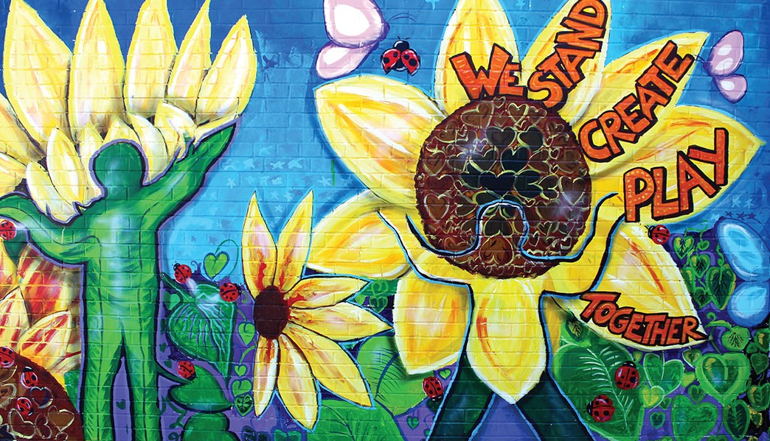
Annually
1 million
Americans
celebrate at
8,000+
EVENTS
nationwide
Notes:
This year’s poster was painted by students of the LEAP afterschool program at PS100x in Bronx, New York. It’s a copy of the mural on the school building. The flowers have silhouettes of human figures that represent different ages and the different stages of learning and growth.

Slide 4
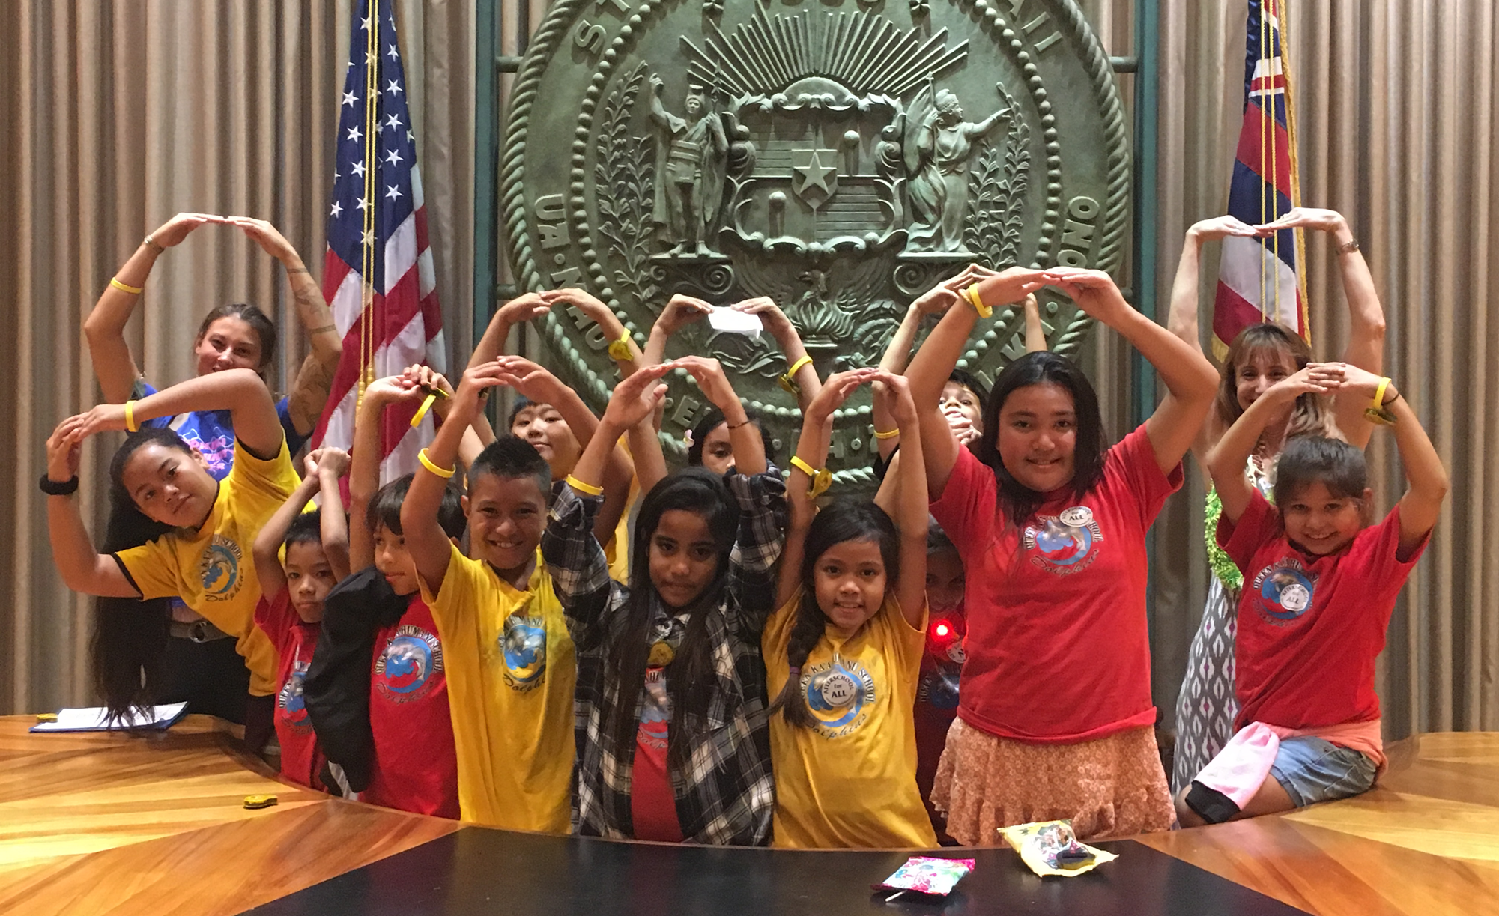
Lights On 101
Why should I host a Lights On Afterschool event?
Call attention to your program’s successes
Show community leaders your kids in action
Start or solidify a relationship with elected officials
Engage private sector and local business
Get media coverage and develop media contacts
Nurture new partnerships and funders
Give your children, staff, and parents something to celebrate
Notes:
The point of hosting a Lights On event is to build long-term support for your program, and for similar programs in your community and in your state.
So, how can Lights On help sustain and promote your program?
This is where relationships with the media and with policy makers come in.
Lights On is more than just a one day thing – through the course of planning your Lights On event, you’ll strengthen relationships and build new relationships with partners in your area. So we’ll be talking a little more about the planning process—to make sure that your event is planned with intention and with clear goals for what you want to come out of it.

Slide 5
Lights On 101
3
Easy Steps
to planning a successful Lights On Afterschool event!
Notes:
Lights On Afterschool events don’t need to be difficult to plan or expensive in order to be effective.
So here are my THREE EASY STEPS FOR CREATING A great Lights On Afterschool Event!
1. REGISTER online
2. PLAN for your event
3. PUBLICIZE by reaching out to your supporters and the media

Slide 6
Step 1: Register
10 free posters
Weekly planning tips, tools, and giveaways
Bike lights and decals from ION
Notes:
Once you’ve registered your event, prepare your mail and inbox to receive a bunch of free resources that include:
--email planning tips and updates every week
--10 free posters to help you promote your event locally
--Raffles and prize giveaways EVERY WEEK among our registered programs for event materials leading up to Lights ON
--your event will be added to our website for the media and your community to see
--your event is counted in our national total!
Registering with us is the only way that we know you’re holding an event and the only way you’ll be able to receive these free resources—that’s why it’s so important!

Slide 7
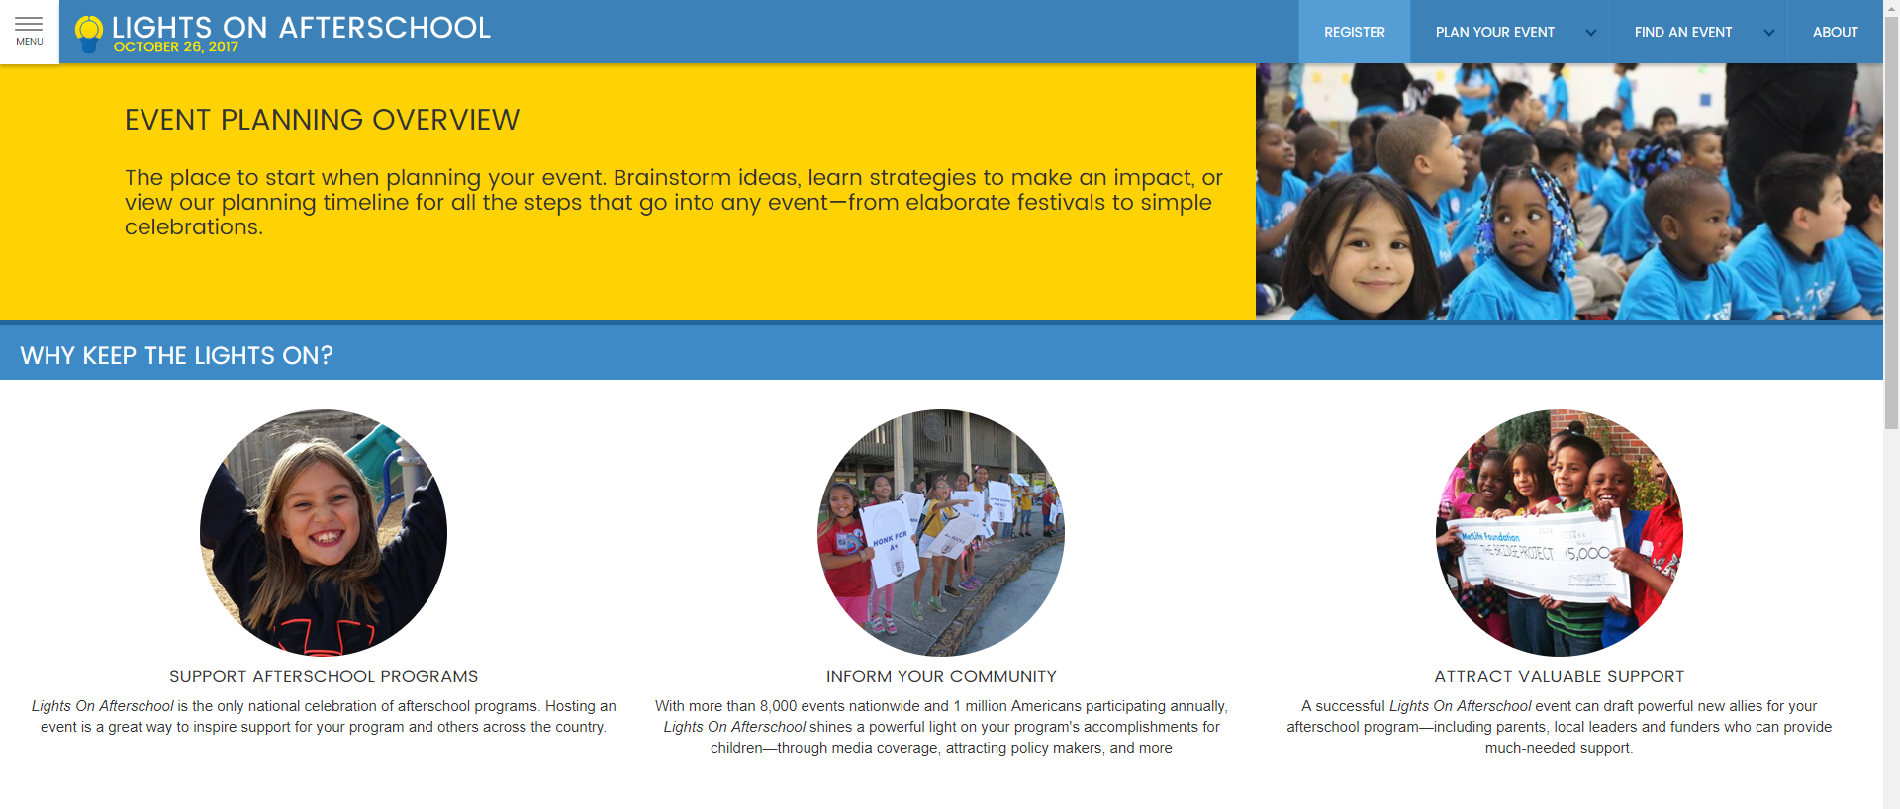
Visit: Afterschoolalliance.org/loaEventKit.cfm
2
Register
Afterschoolalliance.org/loaHostEvent.cfm
Notes:
Visit the website to find our event planning kit that includes step by step information on how to start planning a successful Lights ON afterschool event.
The event planning kit includes:
--sample materials, like invitations and activities
--graphics and logos to download
--timelines and checklists, which are actually the most used resources we have.
--event ideas and case studies
--media materials that you can edit to make it specific to your afterschool program
--handouts and talking points to help share the afterschool story with your community
-- Most importantly, we have entire sections on engaging the media and policy makers

Slide 8
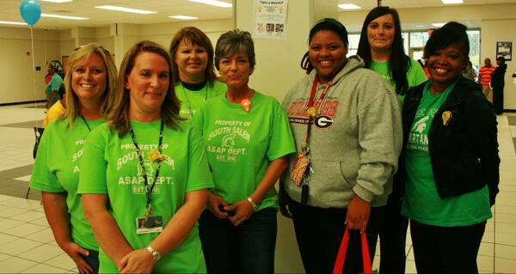
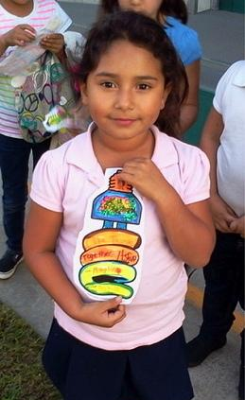
Step 2: Plan Your Event
The Event Planning Guide has everything you need to:
Help to think about your goals/needs & get started with the “who, what, when & where”
Showcase students & tips on involving youth in planning and celebration
Involve partners & use your own or see our list of local supporters
Sample invitation to policymakers, business leaders & more!
Notes:
Now that you have access to the tools and resources you need, it’s time to think about your goals for hosting a lights on afterschool event.
Who are you trying to reach with your message and who is best to deliver that message?
What do you want to be the result of your event?
Do you want media coverage, or a better relationship with the mayor or police chief?
Also think about your needs.
What can you feasibly do with the resources and time that you have?
Will you need to find sponsors or donors?
Are there partners in your community with whom you can team up?
We also have tools to help answer these questions before you start planning.
One great way to showcase students is to make sure they are involved with the planning and execution of your event wherever possible. Whether that be through demonstrations, giving speeches, being tour guides, planning out event activities or making decorations, there’s no wrong answer.
It’s also important to involve partners however you can – for example, enlist board members to introduce students and ask donors to attend to see what you’re up to. For more ideas, our event planning guide has tools and case studies to help you along the way
Make sure that you come up with roles for local leaders who want to be part of your event. We also have sample invitations and letters to policy makers that you can customize.

Slide 9
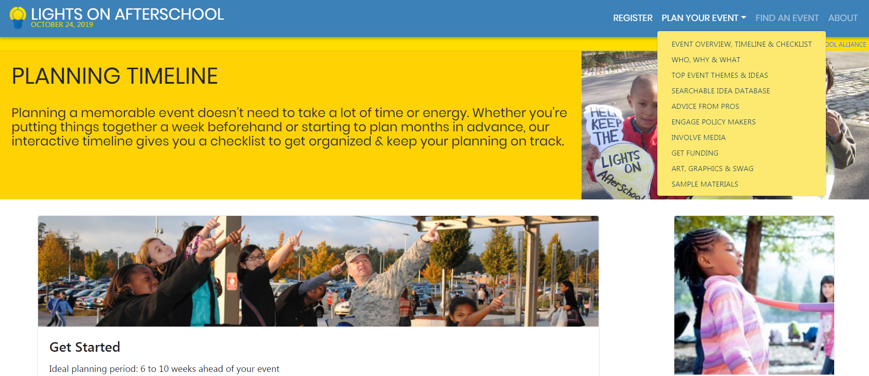
Event Planning Tools
Notes:
The event planning kit at www.afterschoolalliance.org has tools to help you from the earliest stages to your post –event checklist and everything in between. Use it for idea brainstorming stage to creating materials to inviting media and policymakers to promoting your event online.

Slide 10
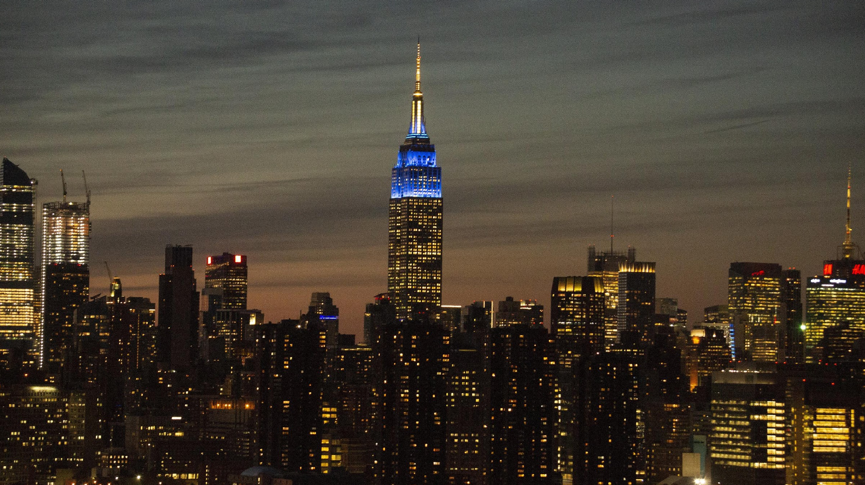
Step 3: Celebrate!
Notes:
After the hard work of planning has been done, celebrate your accomplishments, with award ceremonies, contests, open houses and family dinners with the rest of the afterschool program staff, youth and guests on October 20th

Slide 11
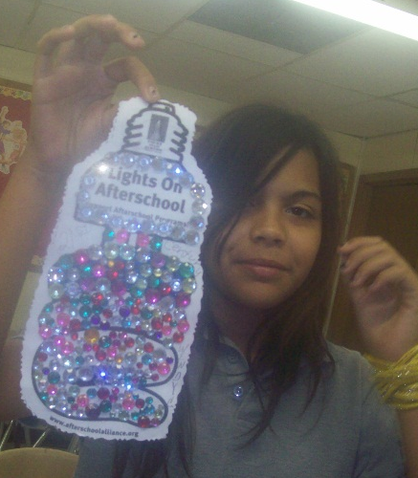
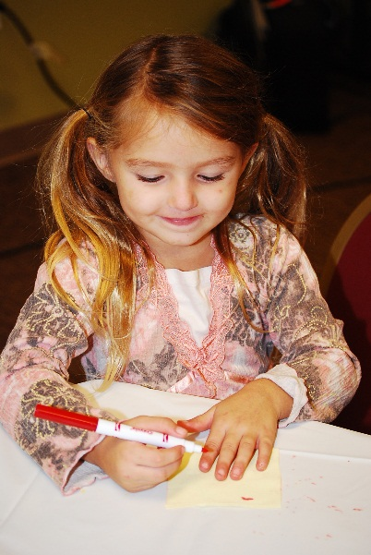
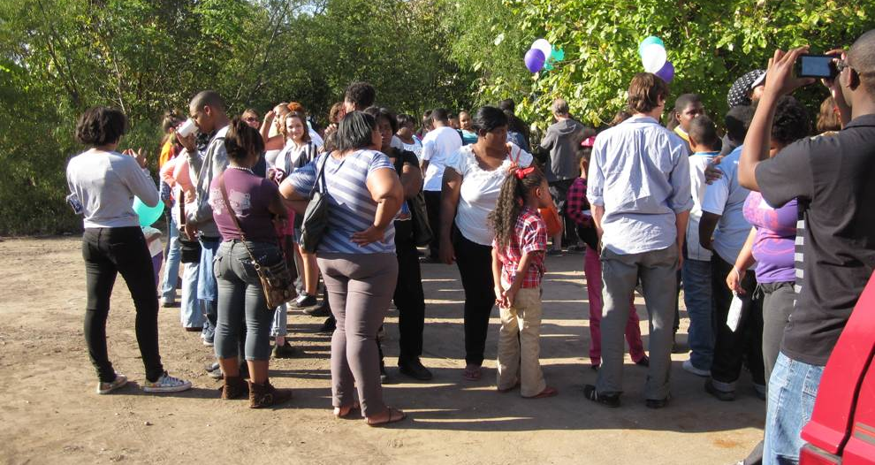
Events Can Be Easy
Decorate light bulb art
Host an open house
Put on a talent show
Notes:
Now what should you plan to do during the celebration?
Planning an event like this may seem daunting, but like I said, Lights On Afterschool events don’t need to be hard to plan!
There are plenty of quick ways to celebrate Lights On that don’t take a lot of time, money, or resources – for plenty of ideas and inspiration just check out our website at afterschoolalliance.org/loa.
One easy way to celebrate is by using our light bulb art. Just print out and decorate lights on afterschool light bulb art as your Lights On event. Have students write on the light bulbs why afterschool is important to them, then afterward, mail them to your elected official’s local office along with a note about your program, and maybe include notes from students for good measure!
Open houses and site tours can be fun, easy ways to showcase all of the great things you do every day. Invite local leaders and policy makers to join parents on a student-led tour. This gives them the opportunity to hear from those people who are directly affected by the great work your program is doing—youth and parents can often be your best advocates.
Afterschool programs this year have also registered to host family game nights, art and talent shows, carnivals and festivals and more. There are lots of options!

Slide 12
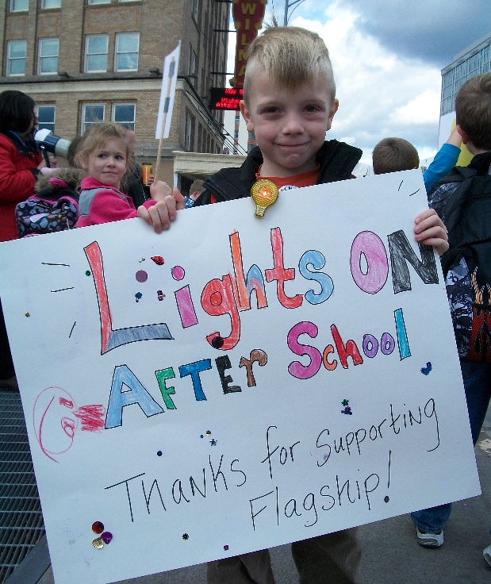
Keys to Success
Build an event around your goals
Make the most of existing relationships & resources
Involve youth
Use Lights On Afterschool for outreach
@idahooutofschool
idahooutofschoolnetwork
#LightsOnAfterschool
Notes:
Here are some key points to keep in mind for a successful lights on afterschool celebration:
Make sure to broadcast your event and use it to build support in your community. Remember, all you have to do is register and we’ll send you 10 free posters to help promote your event in your community.
Don’t forget to promote your event on social media! Facebook and twitter can be very effective ways of getting the attention of elected officials, policy makers and the media
Know that you’re not alone! It’s always a good idea to leverage the relationships you already have to make the most of this opportunity.

Slide 13
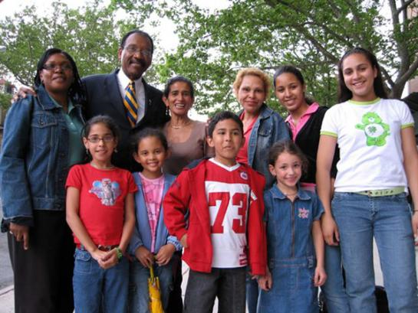
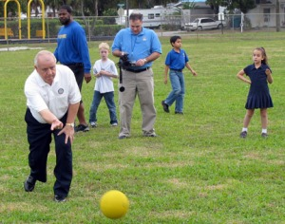
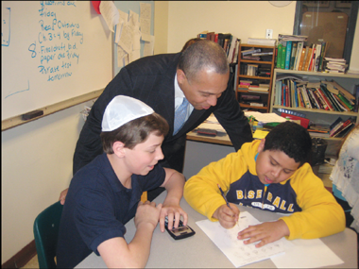
Engaging Policymakers
Invite them to your event for a site visit
Ask them to speak
Give an award
Proclamations
Make afterschool an election issue
http://afterschoolalliance.org/loareachpolicy.cfm
Notes:
Policy makers at every level of government are critical allies in expanding the resources available to support afterschool programs.
Here are some ways that you can involve elected officials—and candidates for office—in your event.
There are sample event invitation on our website, as well as sample proclamations so that they can declare “Lights On Afterschool Day” in your community.
Policy makers may also be great messengers to help deliver your talking points to a broader audience and to add some real muscle to your outreach efforts. Your event provides them with a great opportunity to position themselves as an ally to an important issue that lots of voting parents care about. Having policy makers tour your site or event also gives the press more reason to cover the event, so make sure there are plenty of great visuals for photos.
You can also invite candidates for office during election season, just be sure to give all candidates equal opportunity to participate, so as not to come across as endorsing any one candidate over the other. Afterschool is one of those issues that finds support across party lines. So even if there is an elected official or a candidate who hasn’t supported afterschool in the past, Lights On is a perfect opportunity to educate them on the importance of investing in afterschool.
The website has a guide to help you navigate election season, including rules of engagement for nonprofits so that you’re clear on the law, talking points, advice on how to target your key audiences—including the media and the field of afterschool supporters— questions to ask candidates about their stance on afterschool investments, and tools to help you plan a candidate forum.

Slide 14
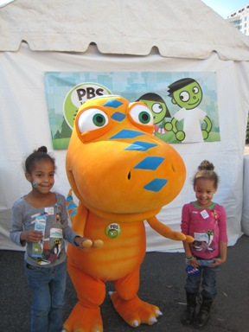
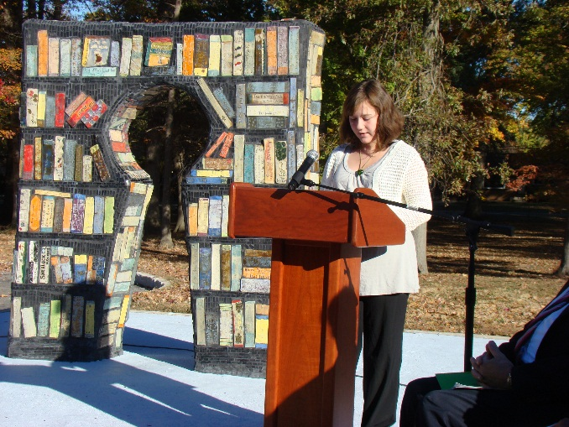
Media Coverage
Structure your event with the media in mind—visuals, timing, speakers
Create a media list
Use the media to invite the public to your event
Identify your key messages—and use them constantly!
Make your story appealing
Issue a news release and press kits
Don’t stop
http://afterschoolalliance.org/loaMediaMain.cfm
Notes:
Lights On Afterschool provides a wonderful opportunity to generate positive news coverage of your afterschool program and to remind the public of the need to provide sufficient funding for afterschool.
Reporters seek out stories that affect the community—they will want to tell readers, viewers and listeners about threats to afterschool programs.
So plan your Lights On Afterschool activities with the media in mind. If you’re trying to involve the media, make sure you have compelling visuals, including banners, and backdrops for speakers and performances. Keep your timing in mind. Daily print and broadcast reporters need to file their stories by early afternoon. Hold the main parts of your event, like speeches or performances, as early as possible in the celebration. For example, if your event goes from 3 to 5, you could do it at 3:15.
You can also make a media list, including local reporters, editors, columnists, bloggers and producers who cover education, children and families, parenting, or workplace and community feature stories. In election years you should also add local politics reporters—especially if you’re inviting candidates.
It can also be a great idea to invite the public! Send out an announcement to the media a few weeks before your. Give them a calendar announcement that they can publish to encourage the public to attend your event.
Make sure that your key messages are integrated into all your media materials and are the focus of remarks. Try to keep it to no more than three main points. Be sure to tailor yours to reflect what afterschool programs mean to your community and the unique challenges facing afterschool programs in your state. Feel free to steal ours:
Afterschool programs keep kids safe, inspire learning and help working families.
Afterschool programs need more resources and more support.
It can also be important to make sure your event has press appeal. Send media alerts to entice reporters to cover your event. Highlight what will happen at your event and why it’s important to the community. We have everything you need on our website.
You can also issue a news release. Send out the release a few days before your event with quotes and event highlights. This will help reporters to cover your story, even if they can’t actually come to the event.
Consider giving press kits to each reporter who comes to your event. Press kits can include things like news releases, background information on your program, fact sheets on afterschool in your area, copies of speaker remarks, letters from kids and families about their experience in the program, copies of any official proclamations, details on upcoming events your program is having, and any other interesting information.
And don’t stop the day of – this is the most important thing! Don’t waste this media opportunity! Keep copies of any stories that aired or were published in order to show them to potential funders, board members, or at future events. Stay in contact with the reporters who came to your event, and pitch follow-up stories when you can, like an end-of-school-year follow-up in May or June.

Slide 15
Resources
Lights On Afterschool Resources:
Afterschool Alliance Website:
http://www.afterschoolalliance.org/
Lights On Afterschool Homepage:
http://www.afterschoolalliance.org/loa.cfm
Register Your Event:
http://www.afterschoolalliance.org/loaHostEvent.cfm
Lights On Afterschool Event Planning Kit:
http://www.afterschoolalliance.org/loaEventKit.cfm
Notes:
That’s all we have for you today! I hope you all feel like a Lights On Afterschool event is doable and can be a great opportunity to build community support for your program.
Once again, our website has all of the tools you’ll need—for free. The sooner you register, the sooner you’ll start receiving weekly planning updates from us.

Slide 16
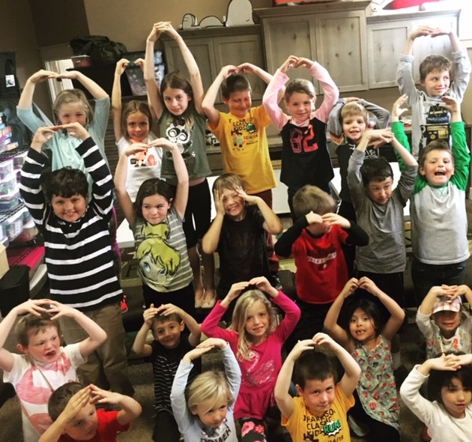
Lights On in Idaho
Nominate an Afterschool Champion through the Idaho Out-of-School Network for an award of $300 to your afterschool program of choice.

Slide 17
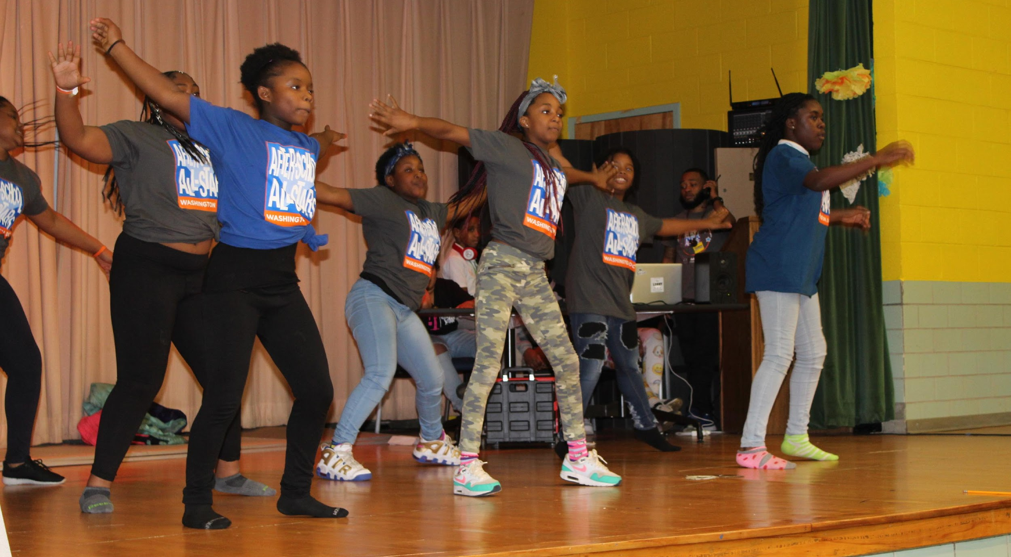
Questions?

